Slide 1
All About Pandas
Emma Caudill

Slide 2
Pandas live in china. They can weigh over 200 pounds. They are giant large and slow. The panda sits down on the ground to eat so that its front paws are free to handle the bamboo.

Slide 3
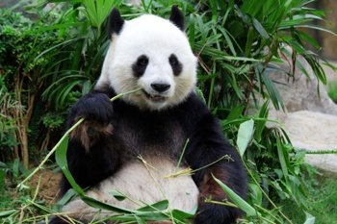
Pandas spend about 12 hours a day eating. Giant pandas are very interesting. A panda may stand on its front paws to leave a scent mark on a tree.

Slide 4
Meet the Author
My name is Emma Caudill. I like dogs. I like to play outside a lot. My brothers name is Jake. He loves to hunt. I love to fish. My nana was the first one to take me fishing.

Slide 5
Dedication
I dedicate this book to my brother Jake because he has strep trote.

