Slide 1
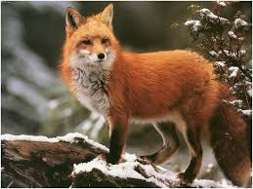
All About Red Fox
By Brielle Wiggington

Slide 2
A red fox lives in, forests, grasslands, and mountains. My animal eats fruits, berries, and grass.

Slide 3
The red fox lives in Canada and the United States. Red foxes are 15 to 16 inches. In spring the red fox eats insects, grasses, and berries.

Slide 4
Red foxes eat corn, apples, and nuts. We eat corn and apples. It will take mothers 90 days to give birth. They have 1 to 12 kits.

Slide 5
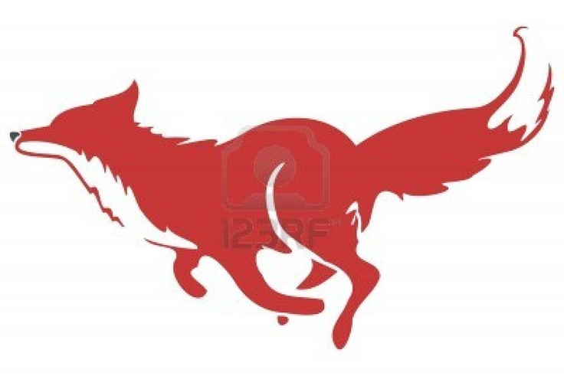
Red fox are the largest of the foxes. A baby red fox is called a kit. I have enjoyed learning about the red fox.

