Slide 1
All about stingrays
By Lakelyn Hoffman

Slide 2
Dedication
I dedicate this book to Wyatt because he is so smart and he also teaches me really cool things!

Slide 3
Scientists have found more than 250,000 kinds of plants and animals living underwater.

Slide 4
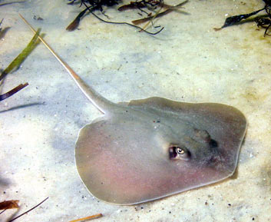
One of the smallest stingrays is the Atlantic stingray.

Slide 5
Their narrow tails have one or more venomous tail spines.

Slide 6
A few stingrays are even found in freshwater rivers in South America and Africa.

Slide 7
I love stingrays because they’re cool!

Slide 8
Meet the Author
Hi, my name is Lakelyn. I love to spend time with my brother. My brother’s name is R.T. He likes to farm but like to play with him.

